Slide 1
Tea House to Town House
evolution of the Japan exhibits at the Boston Children’s Museum

Slide 2
The Kyoto-Boston Sister City Exchange
In the beginning was the Miss Kyoto, a charming doll who came to the Children’s Museum in 1927. It was the start of a relationship that continues today. Kyoto and Boston exchanged friendship dolls, visitors, artists, educators and exhibits, and became sister cities in 1959.

Slide 3
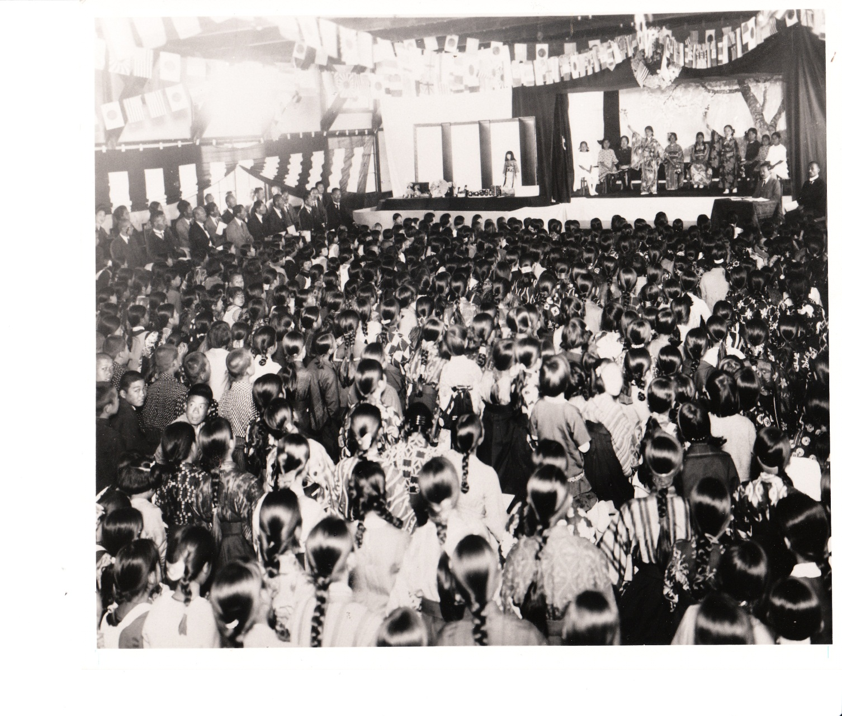
Miss Kyoto and her counterpart, the American Friendship doll Miss Anne, were greeted by crowds and dignitaries during a visit to Japan.

Slide 4
For the 25th anniversary of the sister cities in 1984, Miss Kyoto visited her native country for an expert make-over. In 1985, Kyoto’s Sister City representative and Children’s Museum Director Ken Brecher welcomed Miss Kyoto back to Boston.

Slide 5
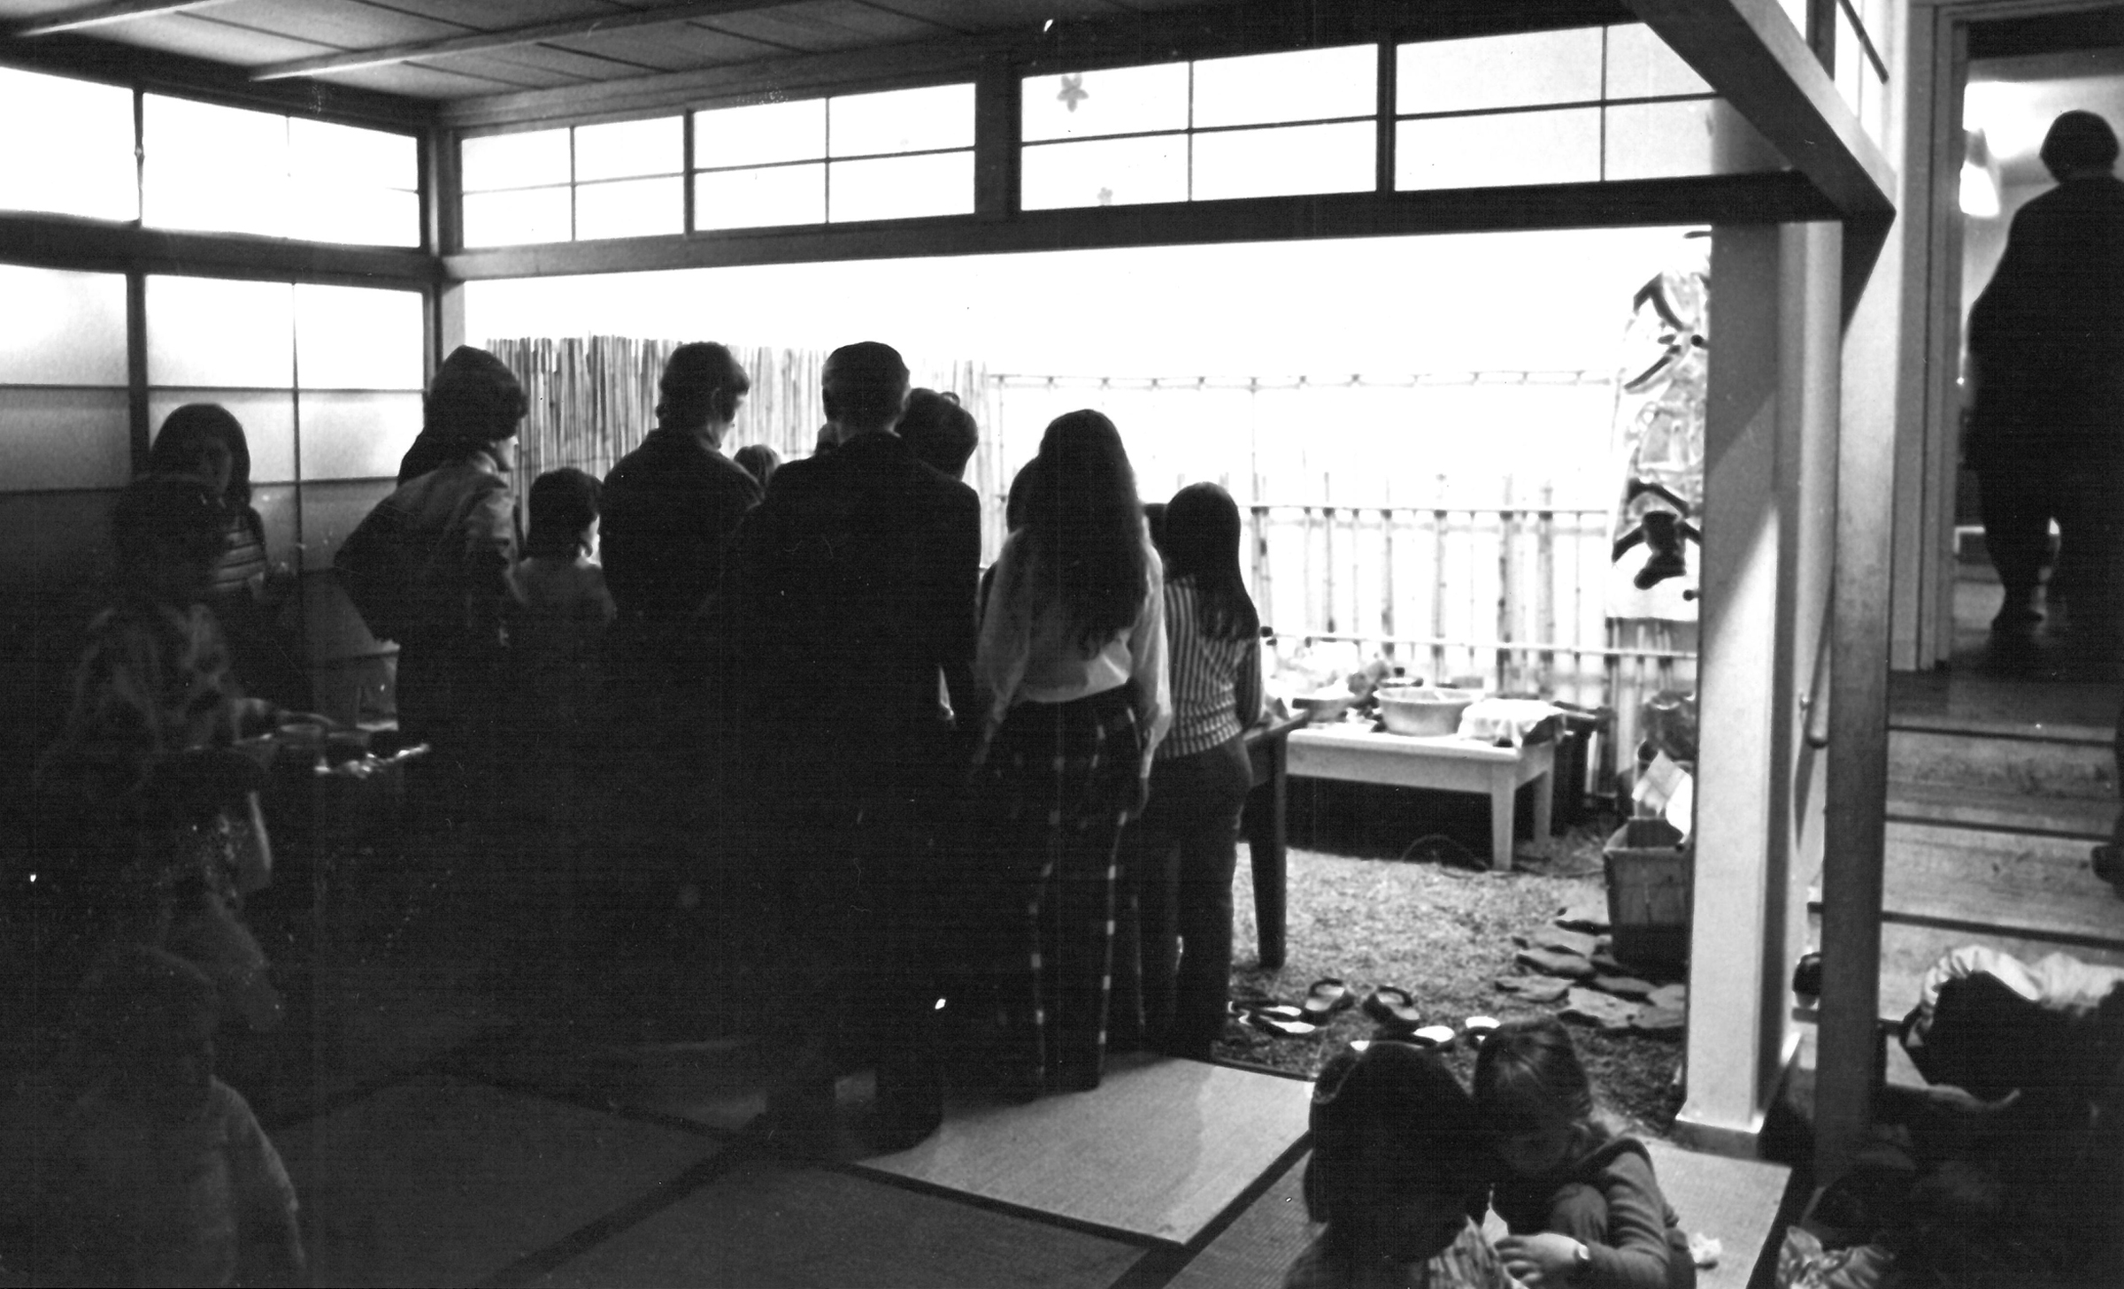
The Tea House
An later gift from Kyoto to Boston was a demonstration Tea Room which we called our Tea House. This was first kept for display at several annual city-sponsored Winter Fests, then housed at a Karate School. Finally, with the enthusiastic urging of museum staff who were working on a Japan Families Kit and help from the President of Boston Gas Company, the tea house was donated to the Children’s Museum in the 1960’s.

Slide 6
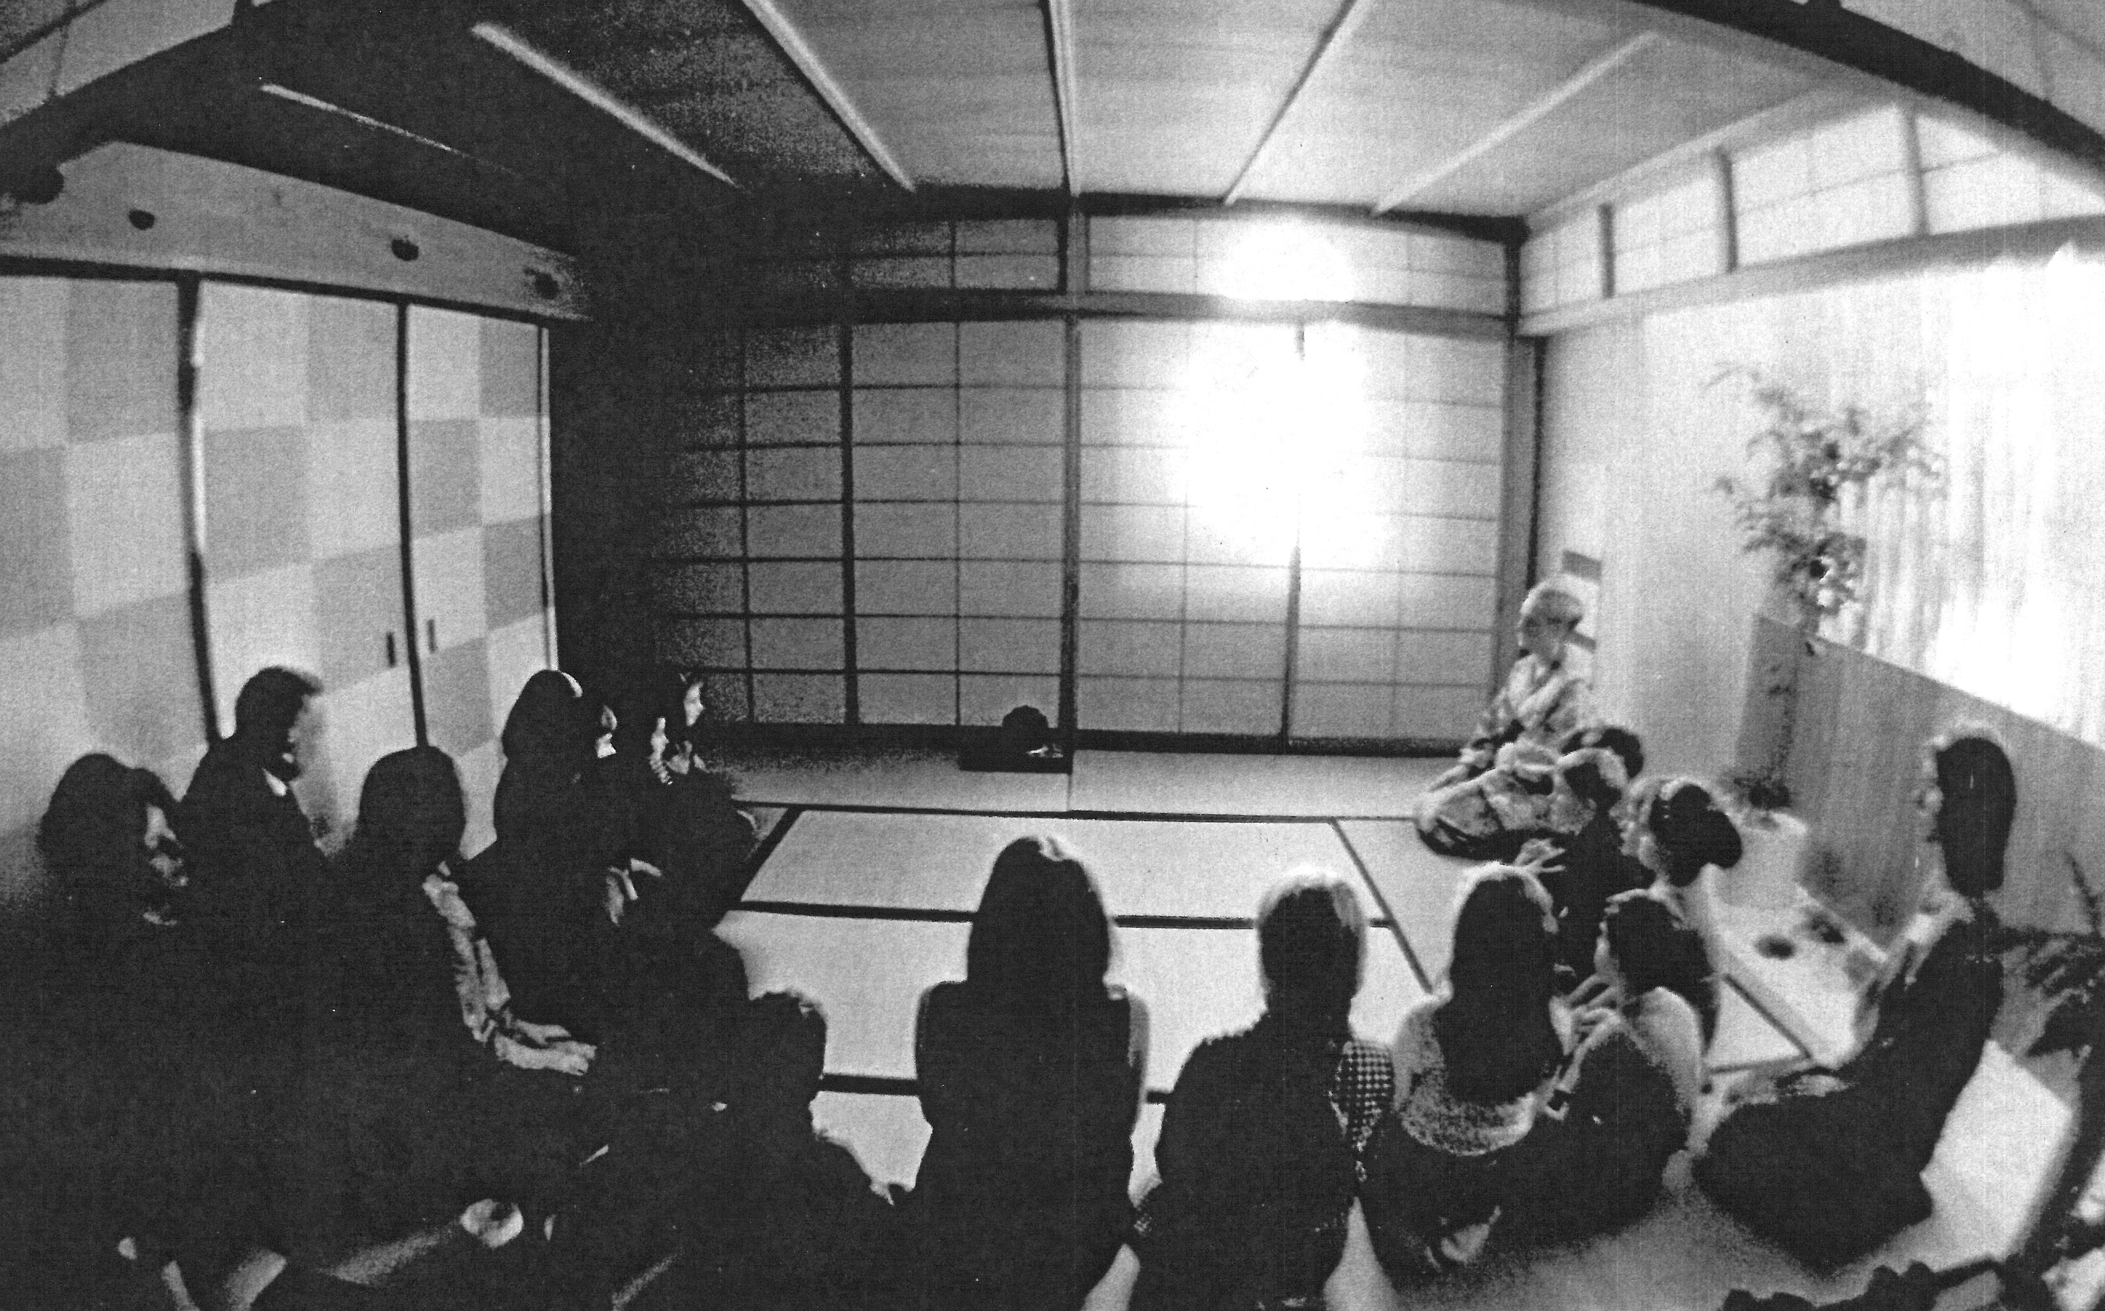
Karen Williamson leading an activity in the Tea House.
Photograph: mid 1960’s

Slide 7
The Spock family in the Japanese Tea House: Mike, Judy, Peter, Dan and Susannah.
photo: by Ted Polumbaum 1968

Slide 8
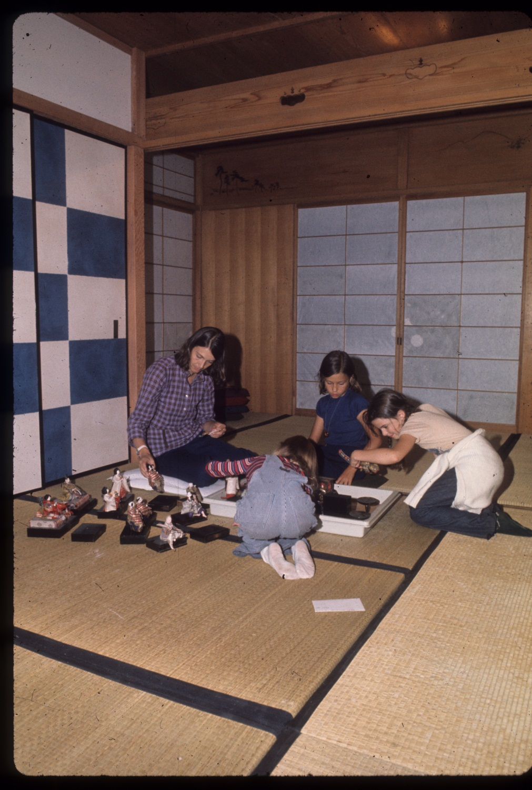
From Tea House to Home
In the early 1970’s, Karen Anne Weisel Zien, the Japan curator and program developer, began transforming the Tea House into an exhibit of Japanese home life: creating an example of living space, re-focusing and expanding the collection, and introducing activities appropriate to children.
Karen Anne, with her daughters Jennifer (facing away) and Becky (in blue) and Susannah Spock, exploring a set of dolls in the Japanese House.
Photo ca: 1976

Slide 9
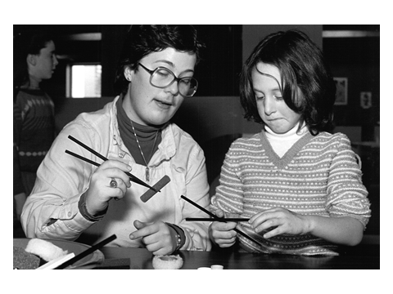
A visitor learning from a program interpreter how to manage chopsticks.
Photograph: mid 1970’s

Slide 10
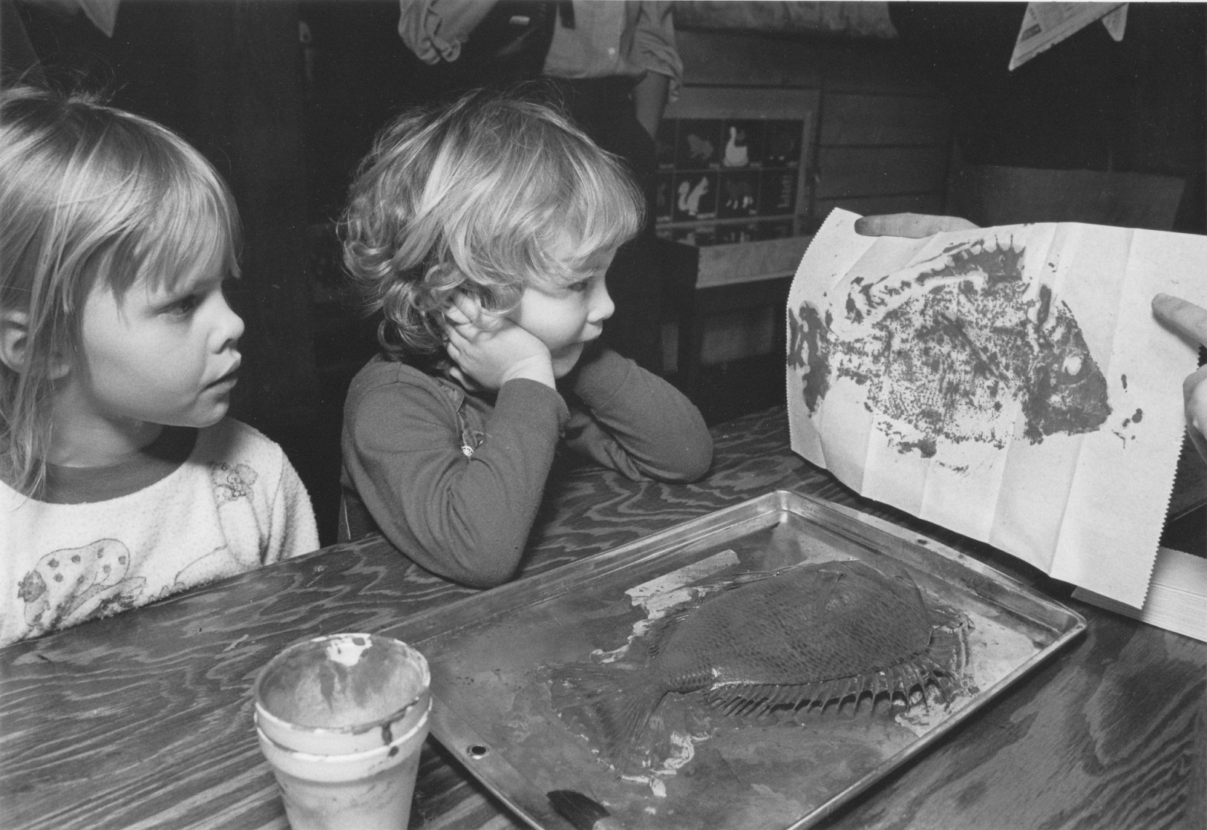
Goyutaku (fish printing) became one of the most popular Japanese activities, engaging even the youngest museum visitors.
Photo: Jon Goell, 1984

Slide 11
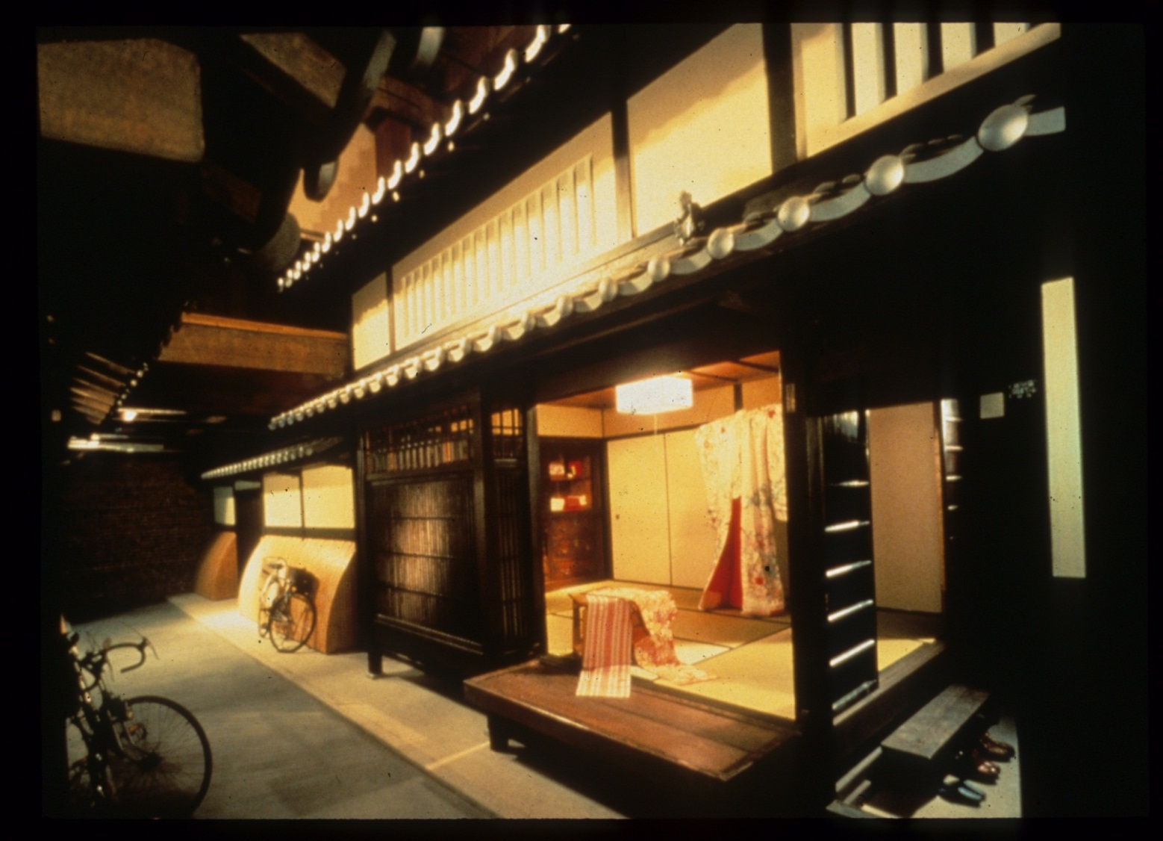
Kyo no machiya: Kyoto Town House
The museum moved to larger quarters at The Wharf, and Kyoto upgraded it’s former tea-house-turned-home with the gift of an authentic 200 year-old urban town house. The first floor and garden were the public/exhibit areas, while tea ceremonies sponsored by the Urasenke School of Tea continued to be held on the second floor of the house.
Photo: Steve Rosenthal, 1981

Slide 12
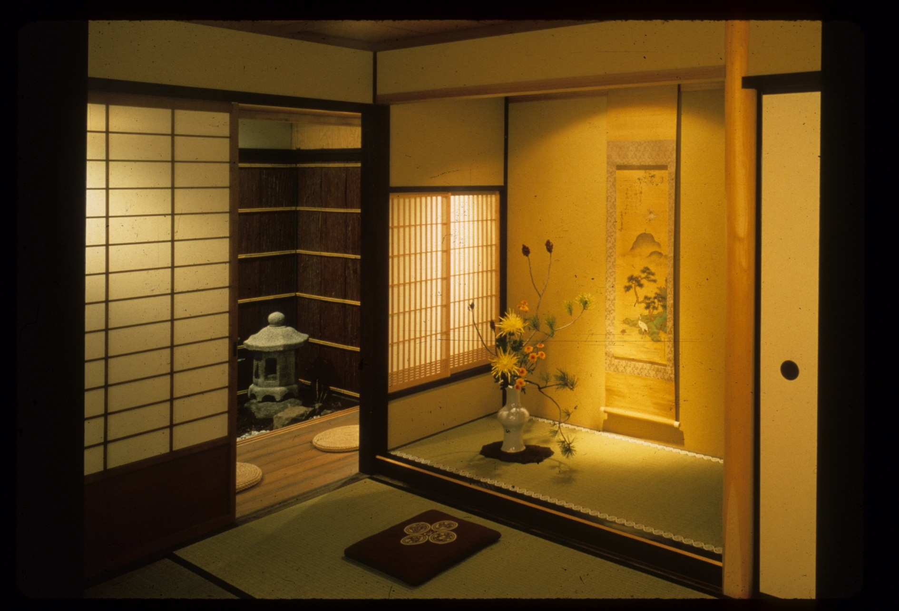
The elegant tokonoma and traditional garden, features of the Kyoto-style Japanese house.
Photo: Steve Rosenthal, 1981

Slide 13
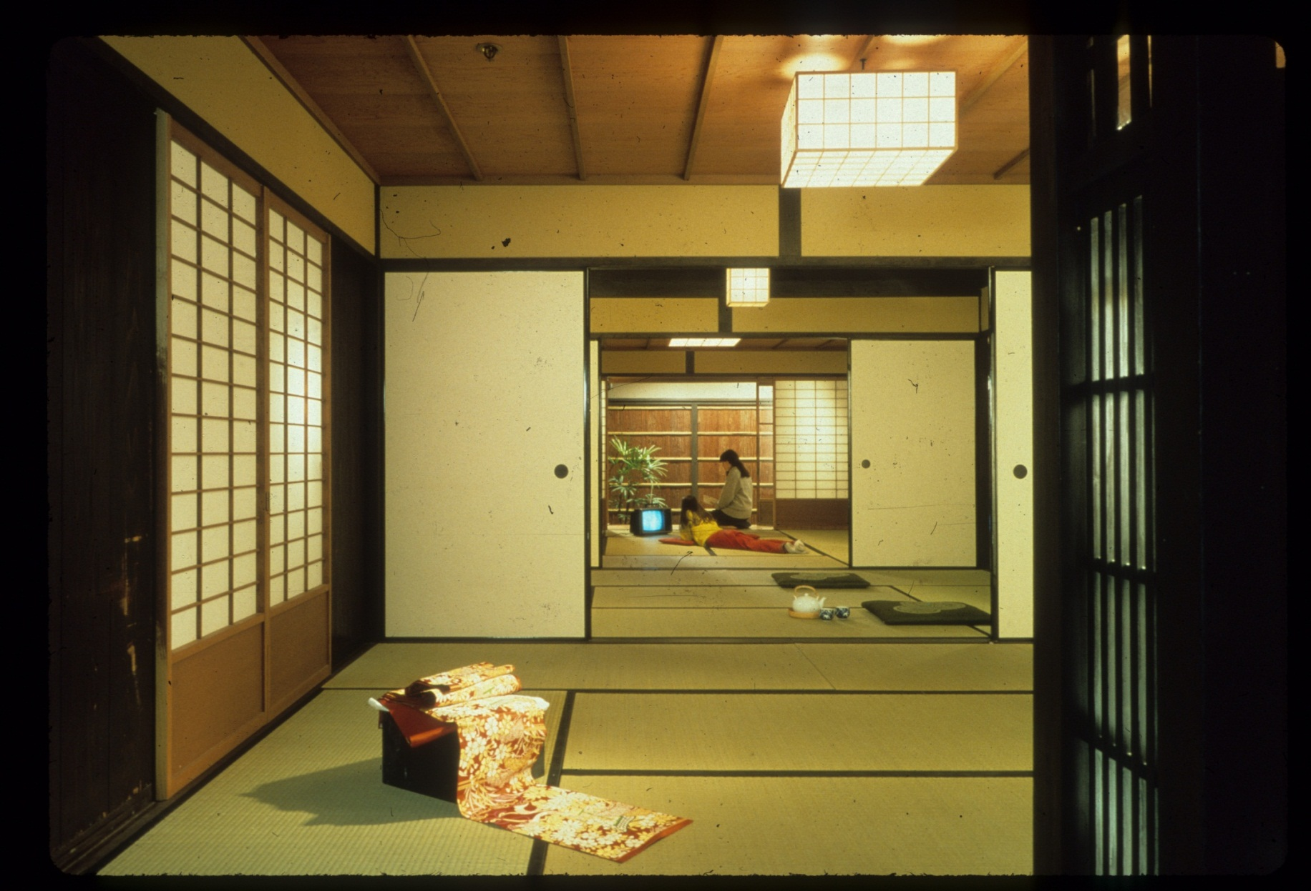
The spacious interior of Kyo no machiya, with a display of fabric that would have been available for customers in the original home/ textile shop.
Photo: Steve Rosenthal, 1981

Slide 14
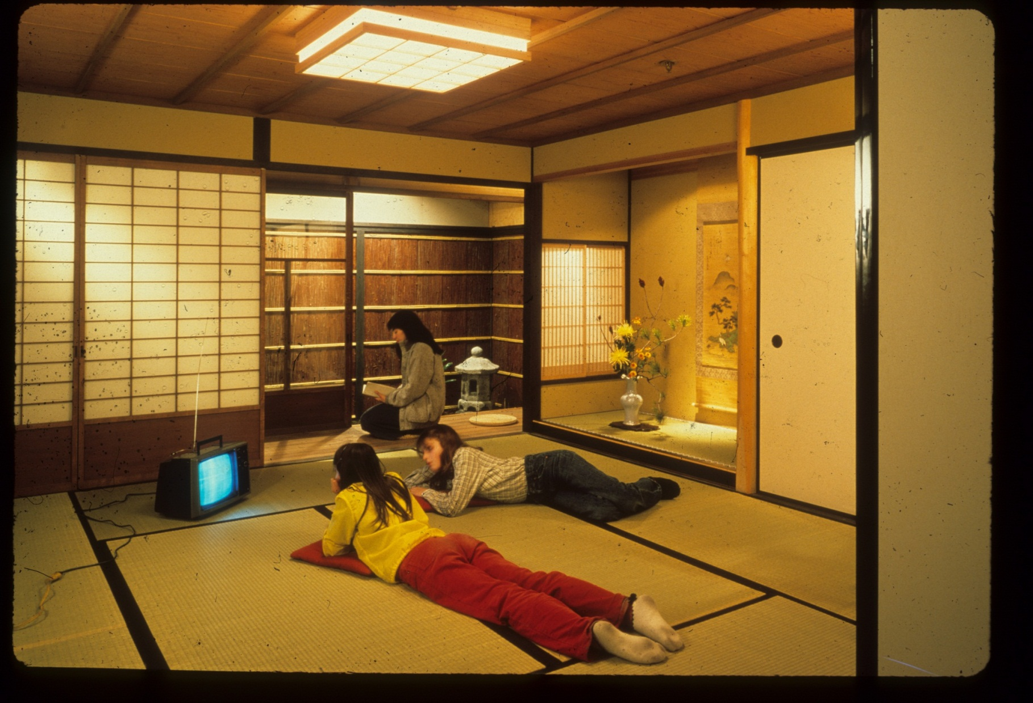
To give the house a more modern feel, the developer added a tv set, along with contemporary toys and groceries on the kitchen shelves.
Photo: Steve Rosenthal, 1981

Slide 15
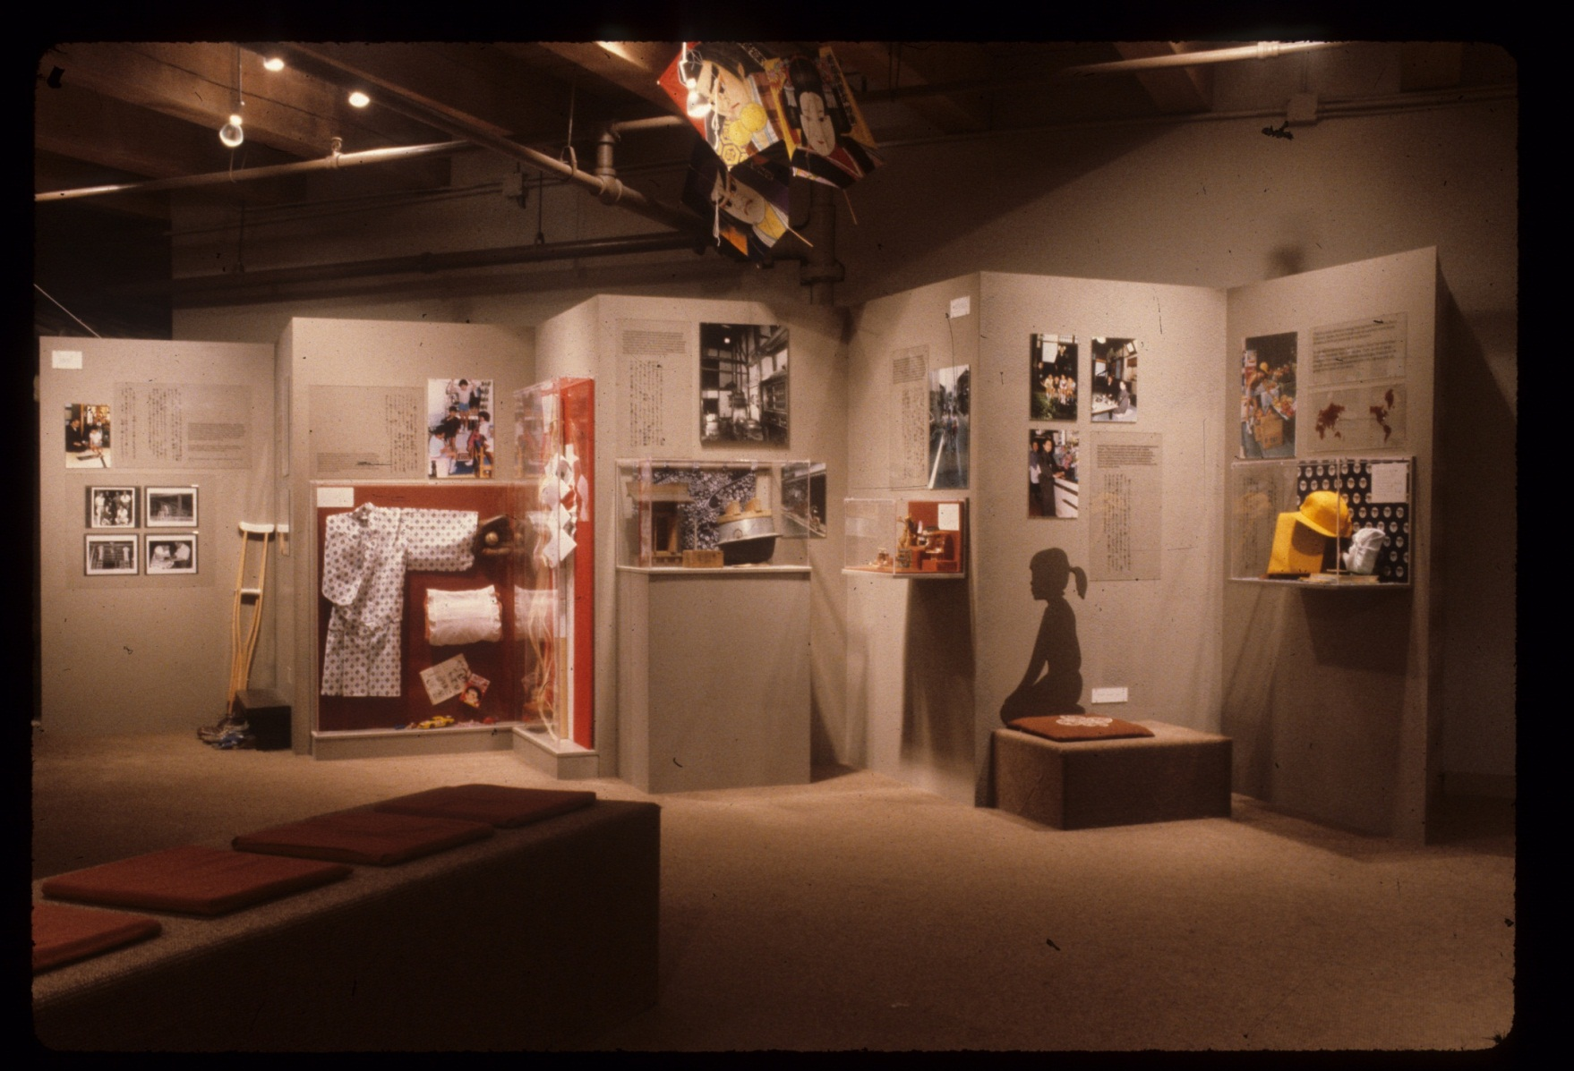
Changing exhibits in the intro area help visitors identify with the activities of today’s children in Japan.
Photo: Richard Howard, 1981

Slide 16
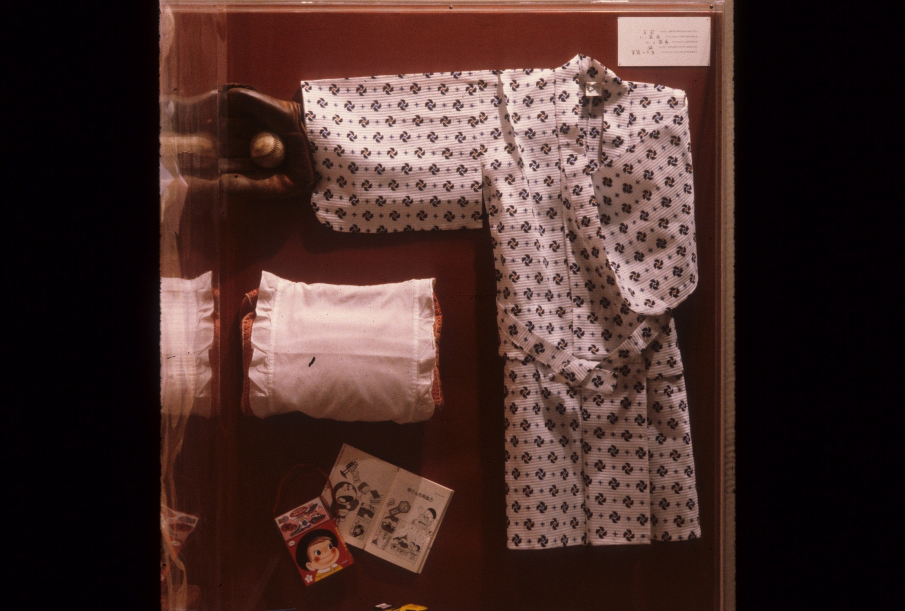
Favorite pastimes of Japanese children including baseball and comic books
Photo: Richard Howard, 1981

Slide 17
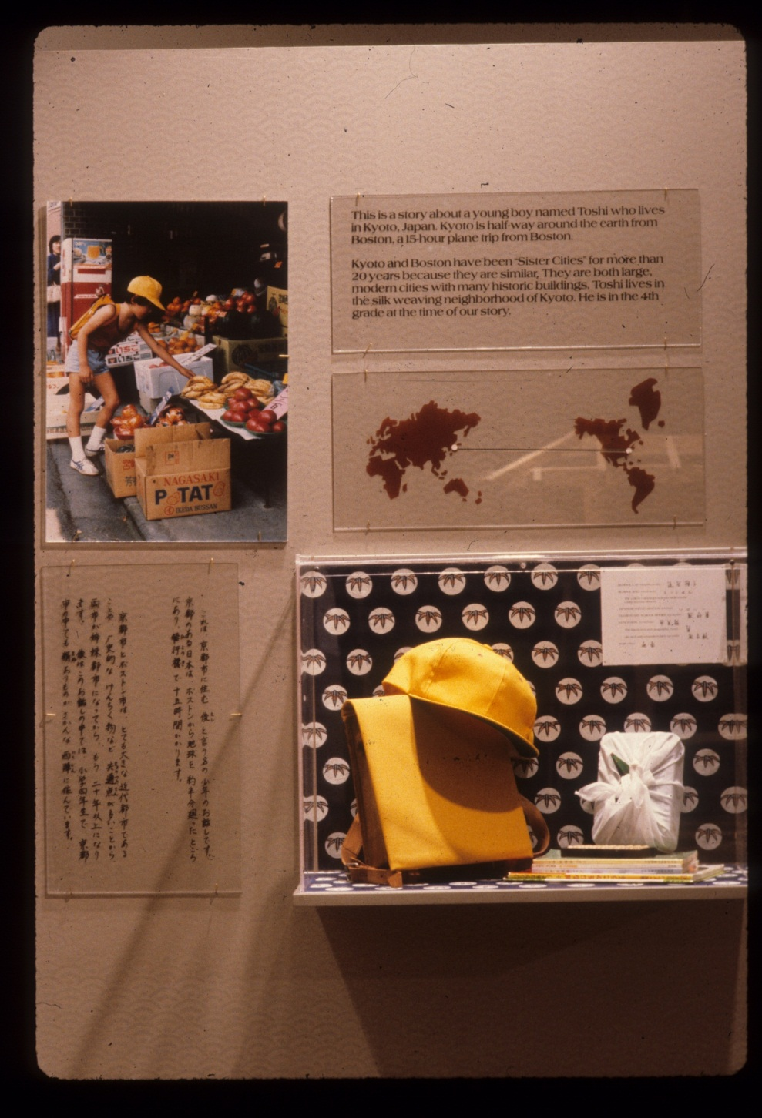
Pictures and objects in the intro exhibit described the daily life of Toshi, a young Kyoto student.
Photo: Richard Howard, 1981

Slide 18
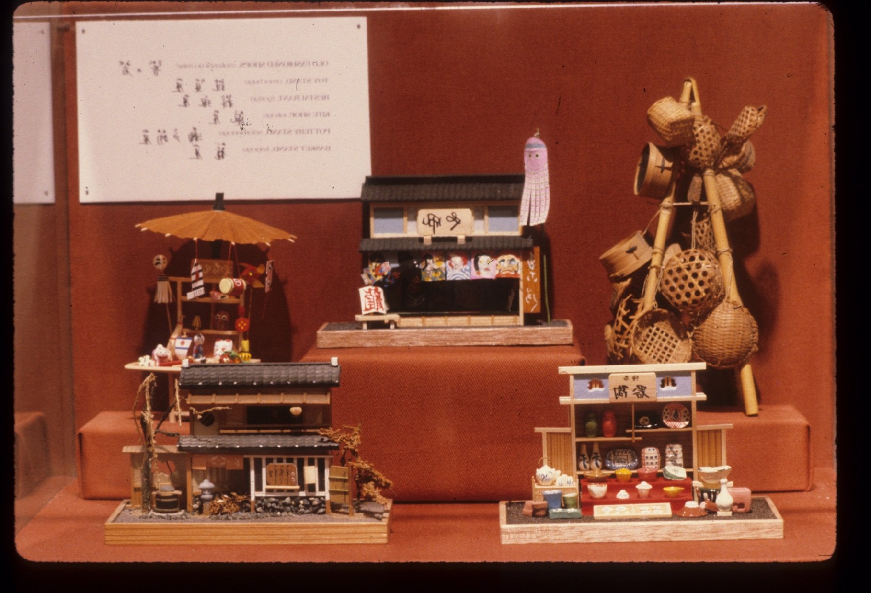
Museum Wharf featured “plum pudding”-- an arrangement of exhibit + classroom + offices + collections all in one bay on the building. The collections space included a display window, accessible shelves of artifacts and a small reading room.
Photo: Richard Howard, 1981

Slide 19
Teen Tokyo exhibiting the contemporary youth scene
Kyo-no-machiya presented a traditional view of home life in one of Japan’s historic cities. Teen Tokyo brought visitors up to date with the youth culture of Japan’s biggest city in a exhibition featuring anime (art comics), karioke, language and music activities, a sumo wrestler, a city subway and the “object theater” presentation of two children’s apartment bedroom.

Slide 20
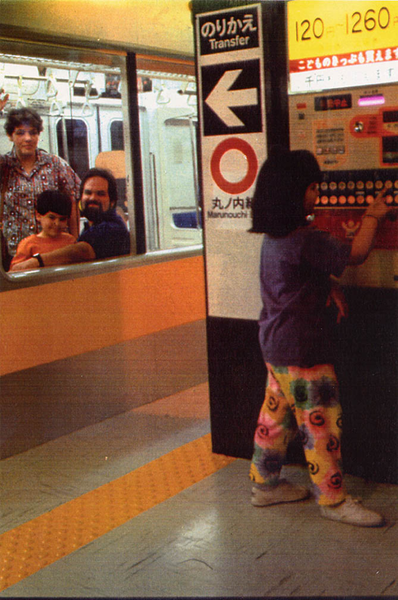
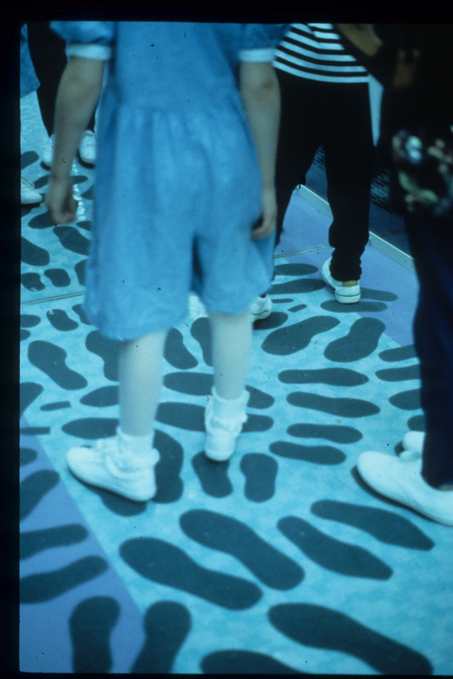
Subway platform with subway.
Footprints on the subway floor help people visualize a crowded subway even when there are only a few inside it.

Slide 21
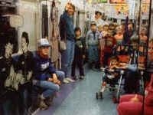
Visitors inside the subway car, a gift from Japan.

Slide 22
At the opening of Teen Tokyo, April 1992 developers, educators, designers and crew pose in the exhibit’s subway.
Front row: Masa Sato, Laura Miyamura, Lisa Sankowski, Ryoko Tokunaga, Mayumi Tachibana, Leslie Bedford
Back row: Yoshi Miki, Mike, Dan Spock, Sing Hanson, Brad Larson

Slide 23
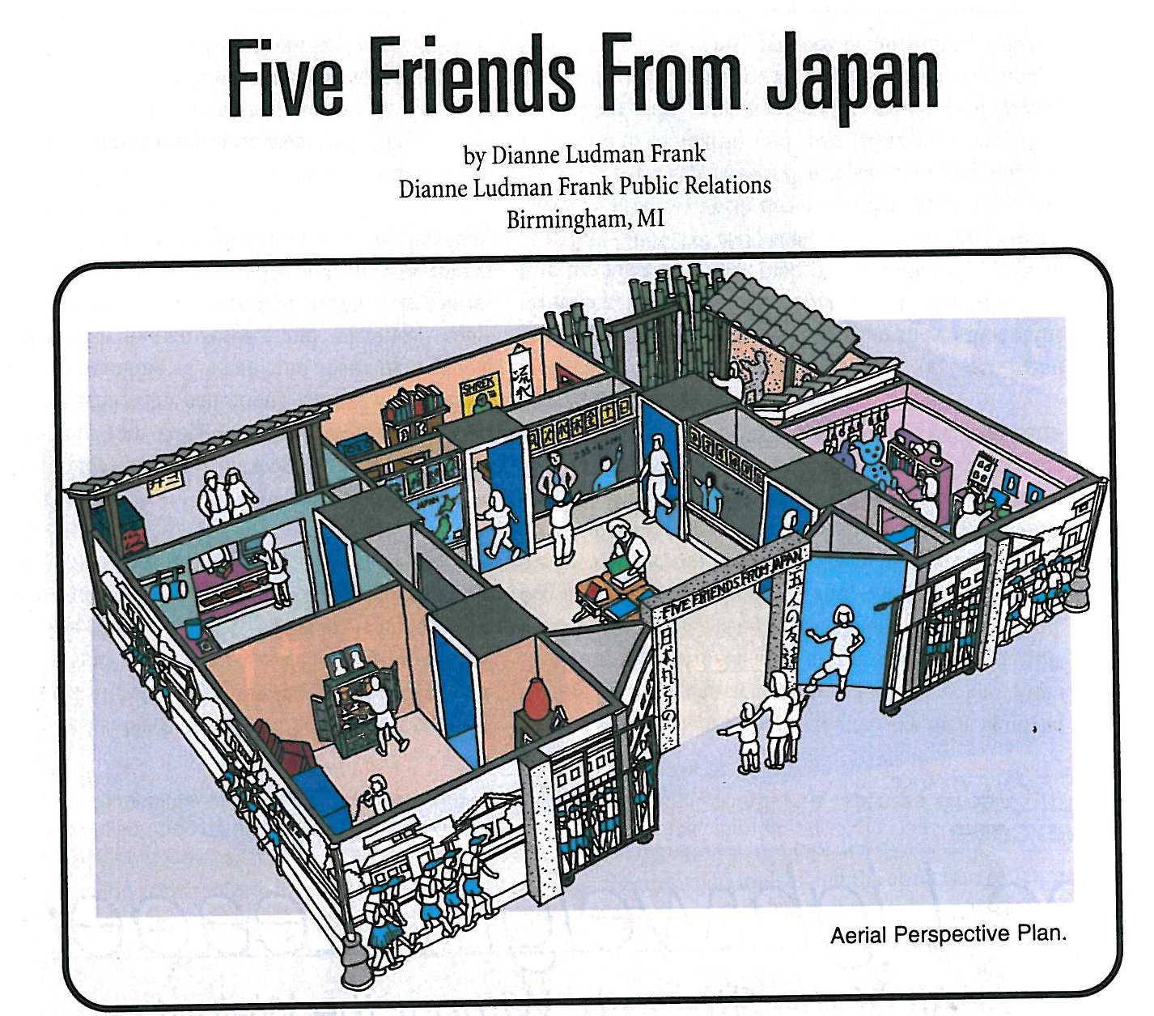
The 21st Century
In 2004, the museum opened Five Friends from Japan, a highly interactive traveling exhibit depicting the home, school and activities of 5 Japanese children.

